Slide 1
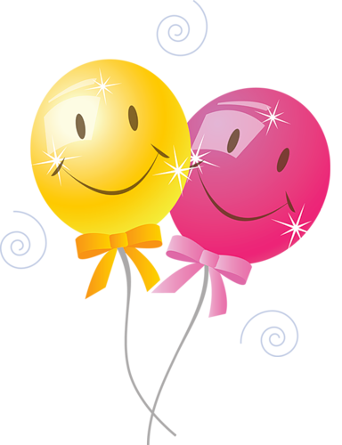

Traditions, Holidays, Festivals
Презентация по теме: «Праздники Великобритании»
подготовила учитель английского языка МБОУ СОШ №19 г. Владимира Акинина Елена Алексеевна

Slide 2
activities
food and drinks
What things come to your mind when you think of traditions and celebrations?
special occasions
presents

Slide 3
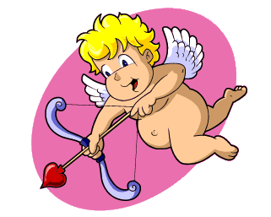
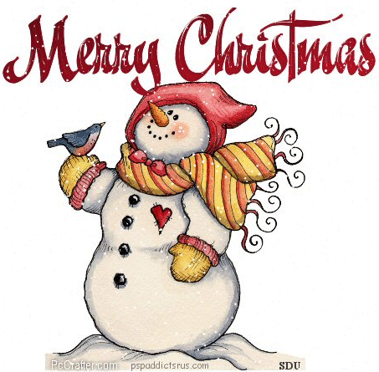
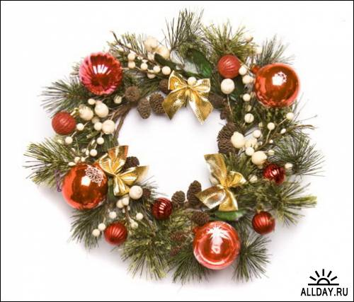
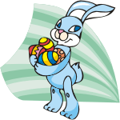
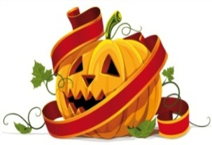
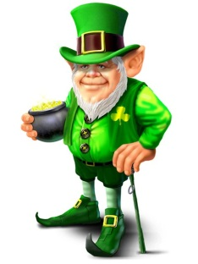
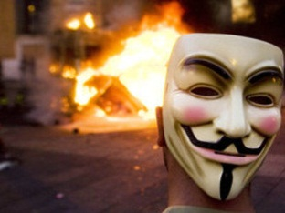
British Celebrations
Christma St Valentine’s Day
New Year
Easter
ST. PARTRICK`S DAY
Halloween
Guy Fawkes Night

Slide 4
Match celebrations with different activities people are involved in
On the New Year’s Day
People set off firecrackers.
People give gifts to their relatives and friends.
People cook dinner for the whole family.
People dye (красят) eggs and present their relatives
and friends with them.
People make fancy costumes and put them on.
People take part in parades.
People go to the church and stay for a service.
People write and send special postcards to those they love.
People decorate fir-trees.
On the Guy Fawkes’Night
On 31 October, Halloween
On Saint Valentine’s Day
At Easter

Slide 5

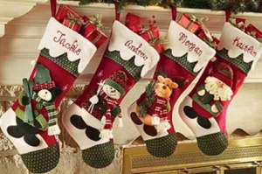
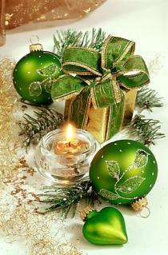
On the 25th
of December there is the greatest holiday of all in England – Christmas. People send X-mas cards to their friends and relatives. People buy a Christmas tree and decorate it with toys, coloured balls and lights.
Children wake up early to find stockings full of small presents on their bed. The colours most closely associated with the Christmas season are: red, white and green.

Slide 6

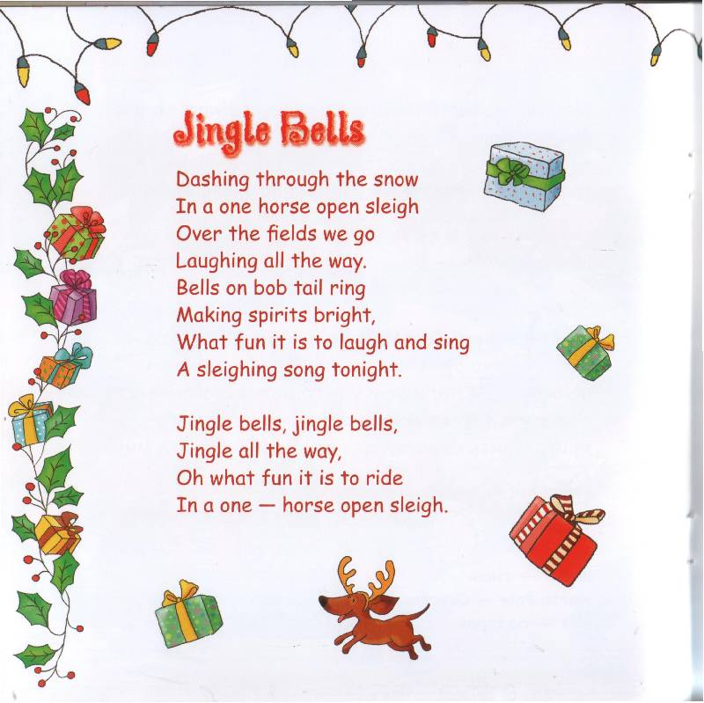
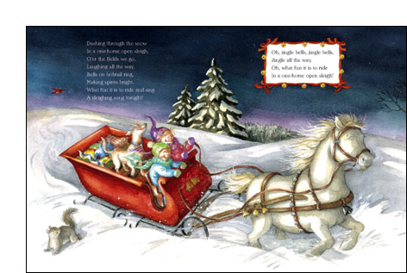
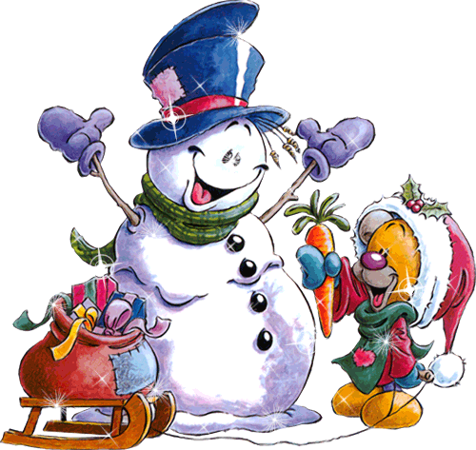

Slide 7
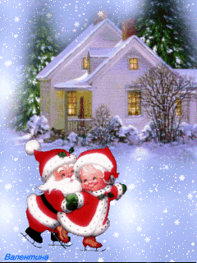
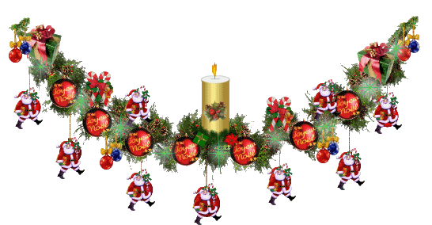
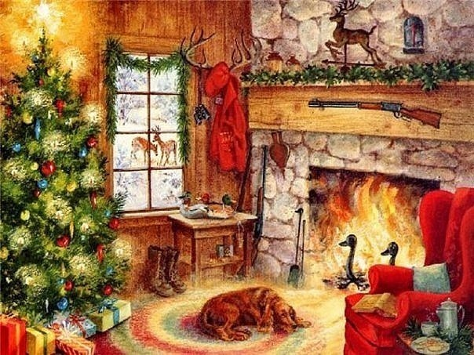
New Year
New Year’s Eve all British celebrate on the 31st of December. Most people see with friends and relatives.
At midnight they sings New Year songs and wishes a happy New Year. Every year the people of Norway give the city of London a present – a big Christmas tree
Some people make New Year Resolutions:
I'll get up early every morning next year.
I'll clean, my shoes every day.

Slide 8
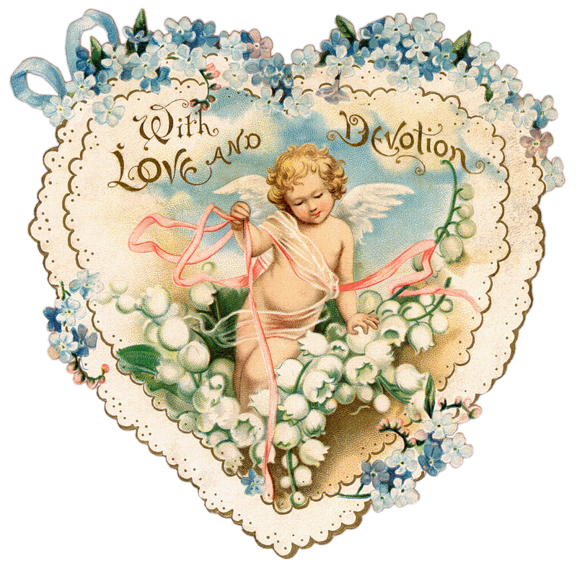
St. Valentine’s day
On the 14th of February there is St. Valentine’s Day. People send Valentine’s cards to someone they love. Usually they don’t sing them – you must guess who sent cards to you. On this day, people send Valentine cards to their husbands, wives, girlfriends and boyfriends. You can also send a card to a person you do not know.

Slide 9
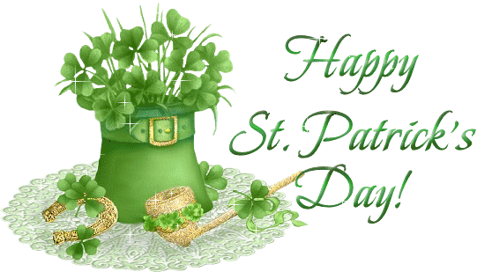
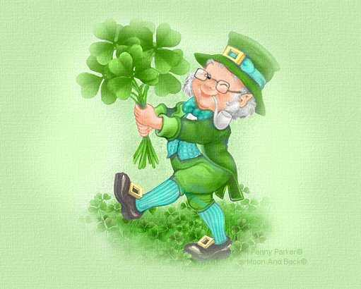
ST. PARTRICK`S DAY
The 17th of March is a national holiday in Ireland – St. Patrick’s day. On that day people wear a shamrock. A shamrock is a plant with three leaves. It is the national symbol of Ireland.
St. Patrick was a man who had wonderful power. He cleared Ireland of snakes

Slide 10
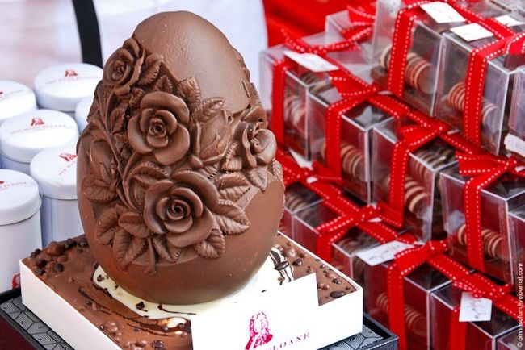
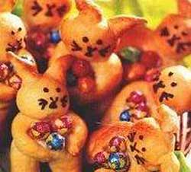
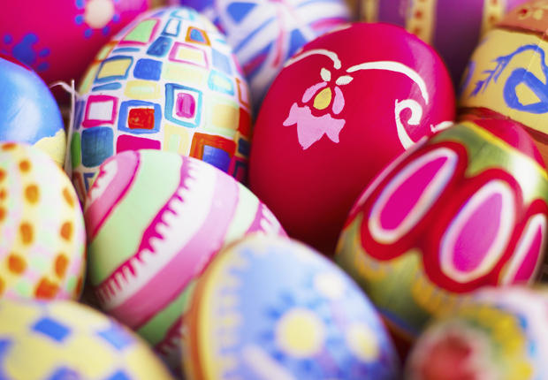
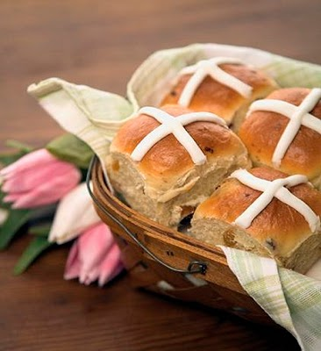
Easter
In April or at the end of March English people celebrate Easter Day.
On Easter Sunday children get chocolate eggs and rabbits.
Many modern Easter symbols come from ancient time.
The egg was a symbol long before the Christian era.
The Easter bunny is also originated in pre-Christian time.

Slide 11
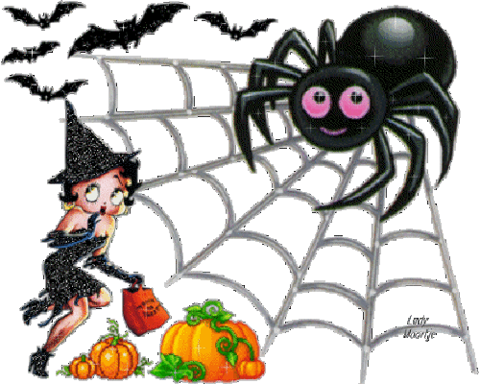

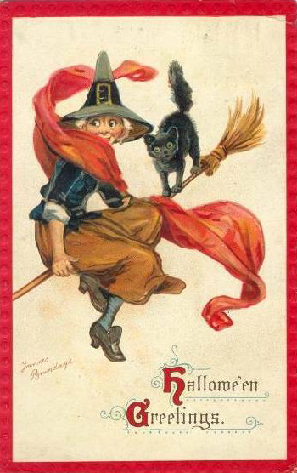
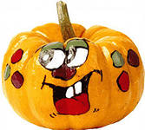
Halloween
On the 31st of October there is Halowe’en. The symbol of this holiday is "Jack o'lantern". People make it from a pumpkin.
Children like Haloween parties, they put on witch’s and ghost’s dresses. They go “trick or treat”.

Slide 12
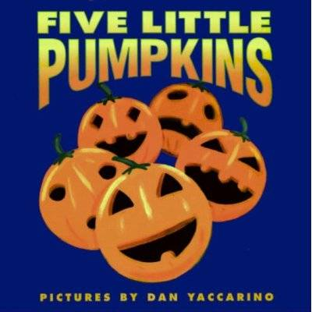
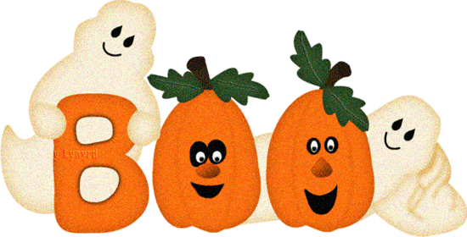
Five little pumpkins sitting on a gate.
The first one said, "oh my it's getting late."
The second one said,"there are witches in the air."
The third one said, "but we don't care!"
The fourth one said, "let's run and run and run."
The fifth one said, "I'm ready for some fun!"
OOOhh OOOhh went the wind
And out went the lights
And the five little pumpkins rolled out of sight.
Пять маленьких тыкв сидит на воротах.
Первый сказал: "О, мой это уже поздно."
Второй сказал: "Есть ведьм в воздухе".
Третий сказал, "но мы все равно!"
Четвертый сказал: "Давайте работать и работать и работать".
Пятый сказал: "Я готов к повеселиться!"
OOOhh OOOhh пошел ветра
И пошел из огней
И пять маленьких тыкв проката из виду.

Slide 13
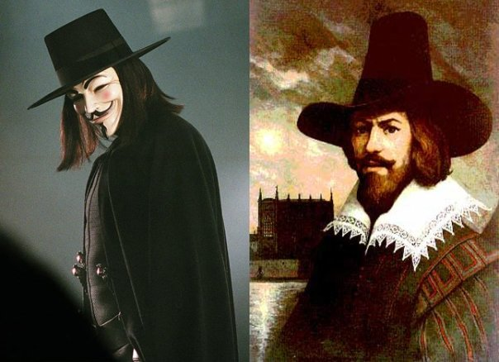
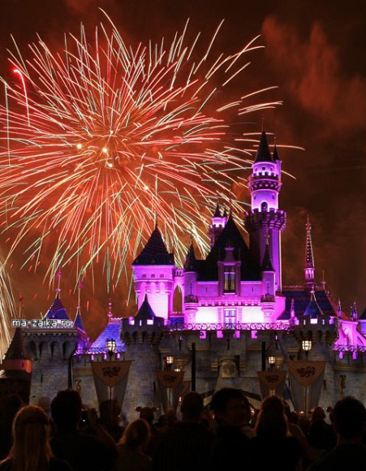
GUY FAWKES ‘ NIGHT— NOVEMBER 5
That day in 1605 some conspirators wanted to blow up the House of Parliament and kill King James I. Guy Fawkes was one of them. The King’s men caught Guy and killed him. Not many people think about those events now but they enjoy celebrating the day with their friends making big bonfires and watching beautiful fireworks. This holiday commemorates the discovery of the so-called Gunpowder Plot and is celebrated throughout the country.

Slide 14
GUESS THE CROSSWORD
T
8
E
9
11
C
C
1
H
R
I
S
T
M
A
S
C
10
E
A
S
U
L
N
T
S
7
H
2
E
K
M
A
S
L
E
N
I
T
S
A
B
S
R
O
L
R
G
M
L
S
T
P
A
T
R
I
C
K
D
A
Y
O
3
T
V
4
N
E
W
Y
E
A
R
E
I
12
B
E
N
I
E
G
5
T
R
A
D
I
T
I
O
N
T
H
D
6
G
U
Y
F
A
W
K
E
S
N
I
G
H
T
Y

Slide 15
Questions to crossword
  English people celebrate this holiday on 25th of December.
  Russian people bake pancakes (holiday).
  This holiday is celebrated on the 17th of March in Great Britain
  The first festival in a year
  England is a country of …s
  English people celebrate this holiday on the 5th of November
  Celebrating this holiday children knock at people’s doors and say “Trick or treat”
  This holiday is celebrated on the last Thursday in November in America
  People dye eggs and go to church in Russia (holiday). .
  So many countries, so many …s
  “Праздновать” in English
  Each person has his or her own date of this holiday

Slide 16
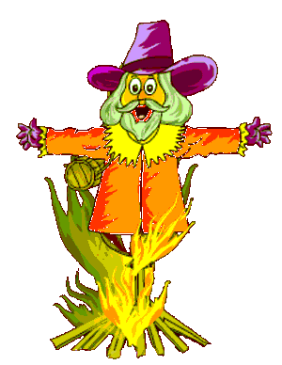
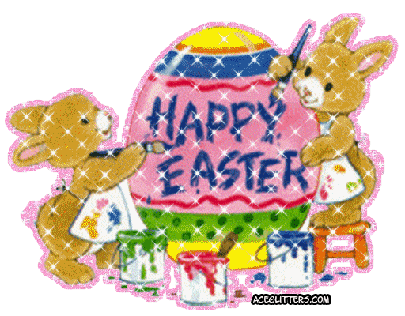
SPEAKING
Imagine that you’re reporters and you are to make a story about one of the holidays. Work in small groups. Choose any card you like and make sentences using these phrases. You have three minutes to finish them so try to do it as quickly as you can.
In 1605
conspirators
blow up the house of Parliament
kill King James I and his ministers
Guy Fawkes
caught and killed
events of long ago
watch fireworks
make big bonfires
Christian holiday
Christ’s return to life
go to church
presents of chocolate Easter eggs
symbols of Easter
Easter traditions

Slide 17
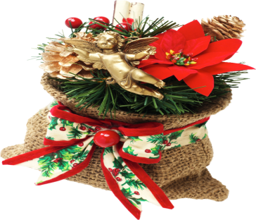

SPEAKING
Imagine that you’re reporters and you are to make a story about one of the holidays. Work in small groups. Choose any card you like and make sentences using these phrases. You have three minutes to finish them so try to do it as quickly as you can.
wish each other
Happy New Year
send greeting cards
New Year’s Eve
have parties
see the New Year in
Big Ben strikes midnight
shout “Happy New Year’
hug and kiss each other
at discos and clubs
old tradition
special greeting card
sweetheart
present
a symbol of love
a name of a sender

Slide 18


